Slide 1
Translational Bioinformatics: From Molecules to Populations
Philip R.O. Payne, Ph.D.
Associate Professor & Chair, Department of Biomedical Informatics
Executive Director, Center for IT Innovations in Healthcare
Co-Director, Center for Clinical and Translational Science, Biomedical Informatics Program
Co-Director, Comprehensive Cancer Center, Biomedical Informatics Shared Resource
Notes:
The clinical template should be used for presentation to a clinical audience and focused on clinical topics. Examples include clinical grand rounds, clinical conferences and seminars and internal clinical meetings.

Slide 2
Outline
Definitions
Challenges
Big data
Reductionist vs. systems-level science
Opportunities
Drug repurposing
Clinical genotyping
Hypothesis generation
Discussion

Slide 3
Outline
Definitions
Challenges
Big data
Reductionist vs. systems-level science
Opportunities
Drug repurposing
Clinical genotyping
Hypothesis generation
Discussion

Slide 4
The Basics: Defining Biomedical Informatics (BMI)
“The field that is concerned with the optimal use
of information, often aided by the use of technology and people (researchers, practitioners, users, etc.), to improve individual health, health care, public health, and biomedical research”
- Hersh, 2010

Slide 5
Another Way of Thinking About BMI (for visual learners)
Mathematics
Computer Science
Information Science
Information Technology
Mathematical & Computational Sciences
Health & Life Sciences
Social Sciences
Biomedical Informatics
Cognitive Science
Management
Sociology
Human Factors
Biology
Medicine
Bio-engineering
Notes:
Intersection of:
Computational sciences
Social sciences
Biomedical sciences

Slide 6
Combining Basic and Applied Science Across Domains
Basic
Science
Biomedical Informatics Theories & Methods
Clinical Research Informatics
Bioinformatics
Imaging & Structural Informatics
Clinical Informatics
Public Health Informatics
Technologies & Tools
Technologies & Tools
Technologies & Tools
Technologies & Tools
Applied
Science
Translational Bioinformatics

Slide 7
The Central Dogma of BMI
Data
Information
Knowledge
+ Context
+ Application

Slide 8
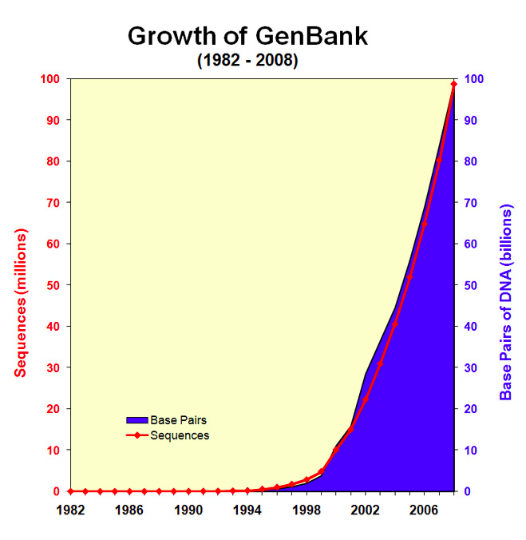
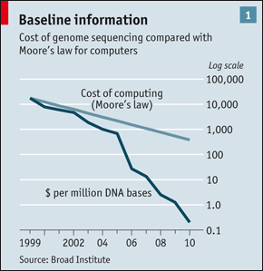
Data Tsunami Facing the Life Sciences
How Do We Make These Basic Science Innovations Relevant To The Clinical Domain?

Slide 9
A BMI Solution to the Data Tsunami: Linking Molecules and Populations
Sarkar IN, Butte AJ, Lussier YA, Tarczy-Hornoch P, Ohno-Machado L. “Translational Bioinformatics: Linking Knowledge Across Biological and Clinical Realms” Journal of the American Medical Informatics Association. 2011. Jul-Aug;18(4):354-7.

Slide 10
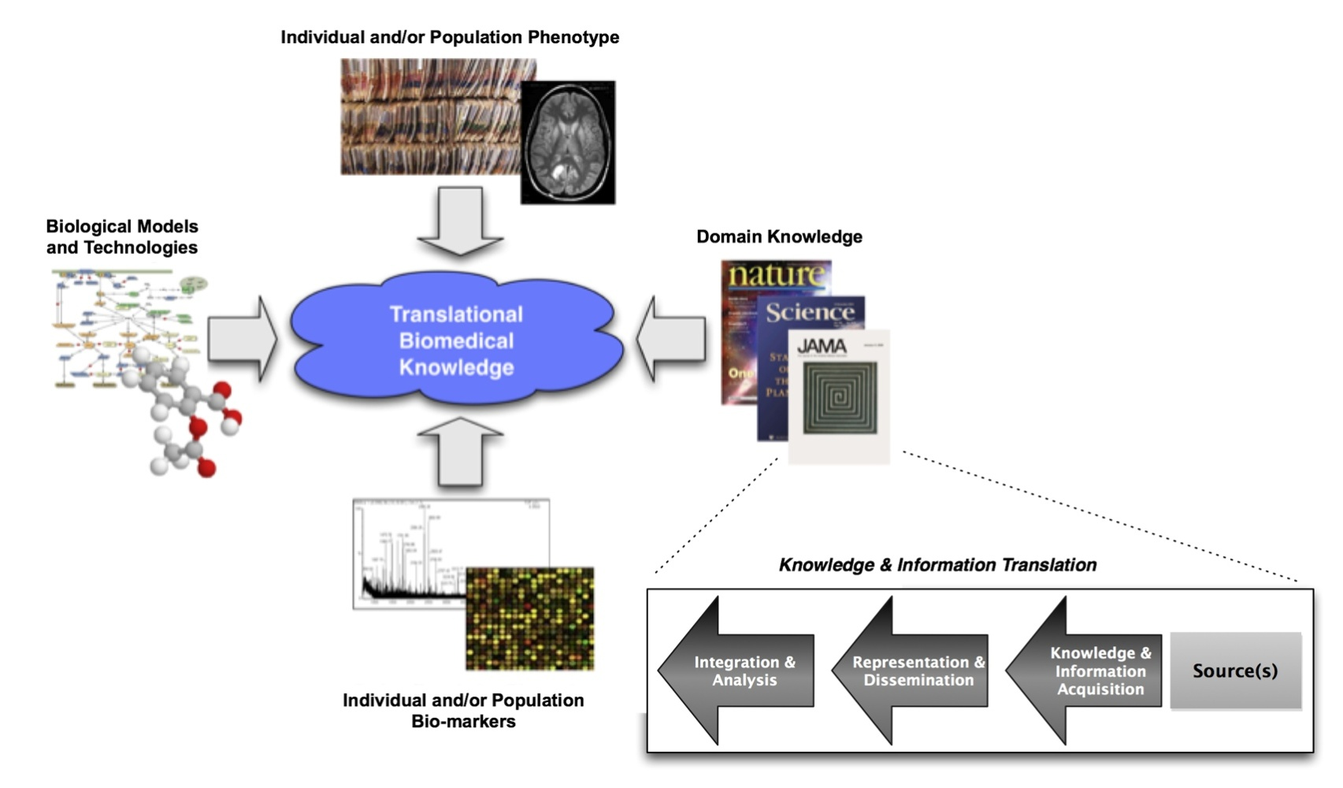
A Formal Definition for Translational Bioinformatics (TBI)
The development of storage, analytic, and interpretive methods to optimize the transformation of increasingly voluminous biomedical data into proactive, predictive, preventative, and participatory health. (Source: JAMIA)

Slide 11
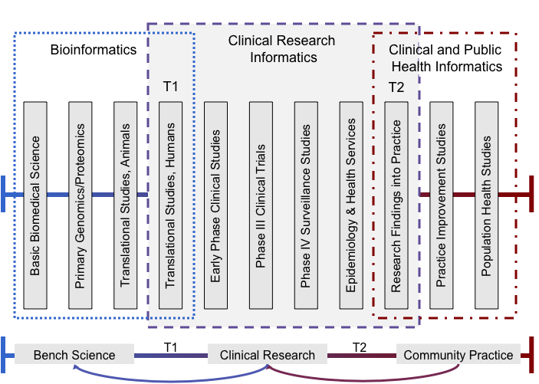
The Bigger Context: The Translational Spectrum

Slide 12
Outline
Definitions
Challenges
Big data
Reductionist vs. systems-level science
Opportunities
Drug repurposing
Clinical genotyping
Hypothesis generation
Discussion

Slide 13



The Basics: Realizing a Leaning Healthcare System is Hard!
Clinical Encounters
HIT + Biomedical Informatics
Research
Data
Generation
Increasing
Distance
Management,
Integration,
Delivery
Knowledge
Generation

Slide 14
Contributing Factors (1)
Regulatory, Technical, and Cultural Barriers Between Data and Knowledge Generation
High performance systems require rapid adaptation
Increasing demand for better, faster, safer, more cost effective therapies
Simultaneous demand for increased controls over secondary use of clinical data
Artificial partitioning of access to data for knowledge generation purposes
Critical overlaps and potential sources of conflict between these factors
Care Providers
Researchers
HIT + Biomedical Informatics
CI, Imaging, CRI, TBI, PHI
Clinical Investigators
Bioinformatics, TBI, CRI

Slide 15
Let’s Focus On…
Big Data
Reductionist vs. systems-level science

Slide 16
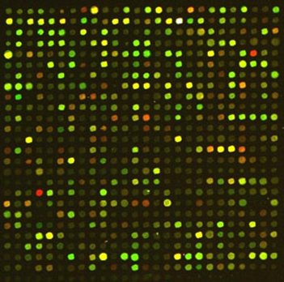
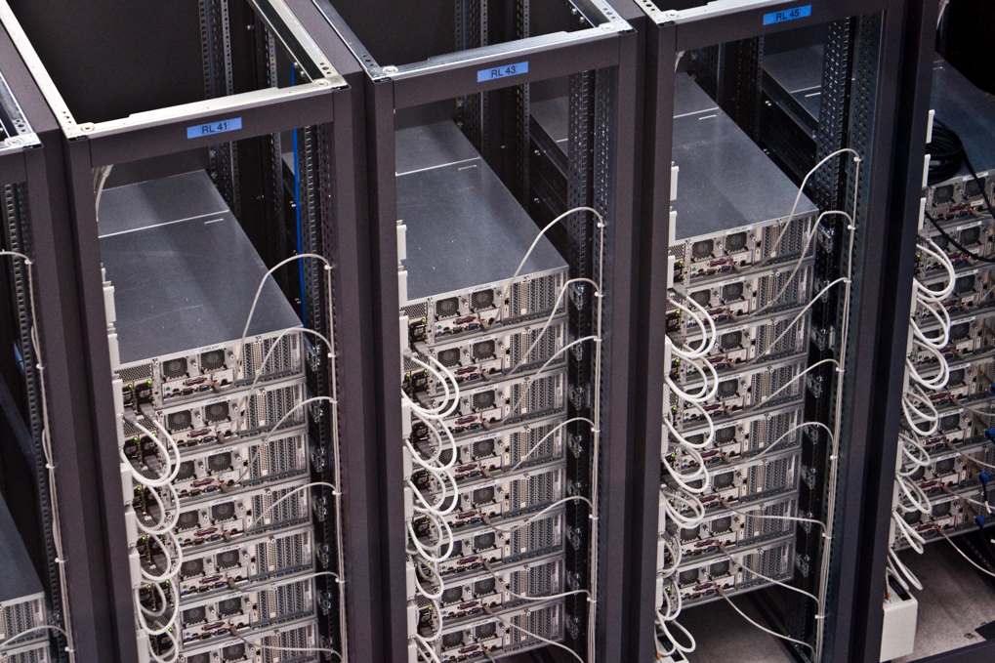

Many Sources of Data!
Emergent Sources
PHR, Instruments, Etc.
Molecular Phenotype
Enterprise Systems and Data Repositories:
EHR, CTMS, Data Warehouses
Environment

Slide 17
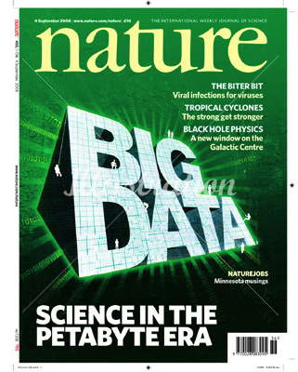
But Reasoning on Big Data Is Hard…
Unexpected problems
Algorithms behave differently
Applicability of convention metrics
P-values don’t mean allot in peta-byte scale data sets
Signal vs. noise
Detection
Understanding of patterns
Physical computing
Data storage
Computational performance

Slide 18
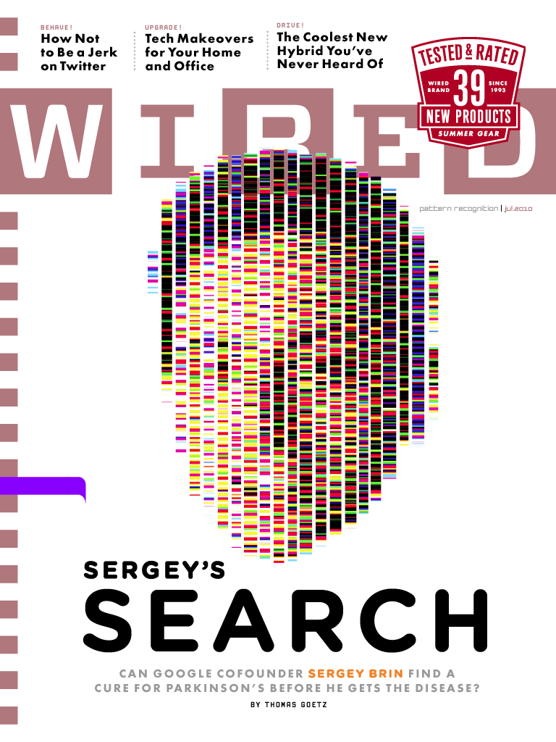
Google + Big Data = Improved Health?
“Sergey Brin’s Search for a Parkinson’s Cure”
Wired Magazine, July 2010
Leveraging Google’s Computational Expertise To Mine Big Data
Distributed computing
Reasoning across heterogeneous data types
Exchanging traditional measures of result validity for the predictive power of increasingly large data sets

Slide 19
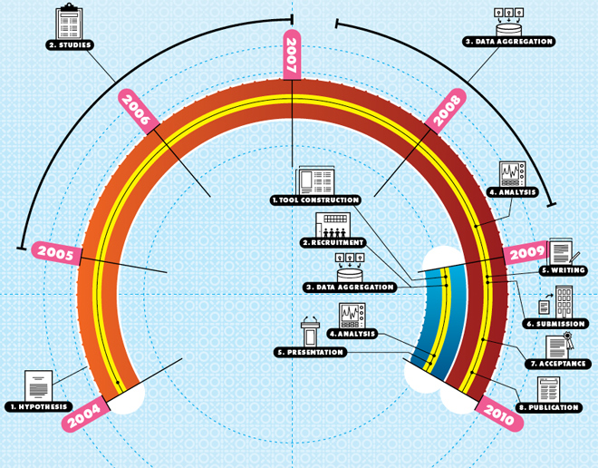
Adapted From: “Sergey Brin’s Search for a Parkinson’s Cure”, Wired (July, 2010)

Slide 20
Contributing Factors (2)
Historical precedence for reductionism in the biomedical and life sciences
Break-down problems into fundamental units
Study units and generate knowledge
Reassemble knowledge into systems-level models
Influences policy, education, research, and practice
Recent scientific paradigms have illustrated major problems with this type of approach
Systems biology/medicine
Reductionist approach to data, information, and knowledge management is still prevalent
HIT vs. Informatics
Informatics sub-disciplines

Slide 21
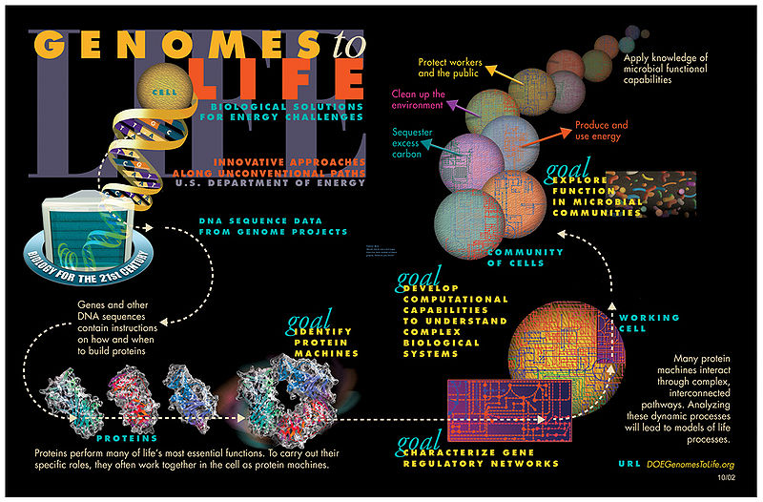
Adapted From: Wikimedia Commons

Slide 22
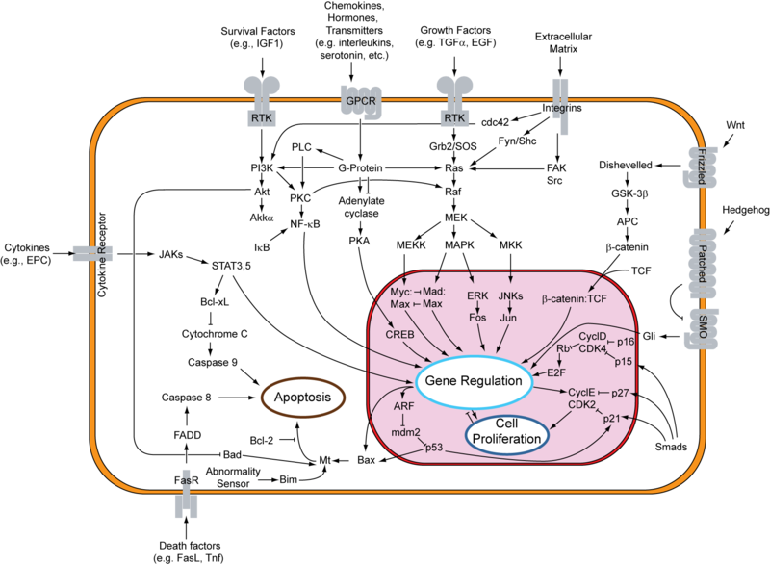
Example: signal transduction pathways
Complex interrelationships
Dependencies
The bigger picture
Scale free networks = natural phenomena
Cannot be readily decomposed or reassembled from constituent components/modules
Systems-modeling is critical!
Adapted From: Wikimedia Commons

Slide 23
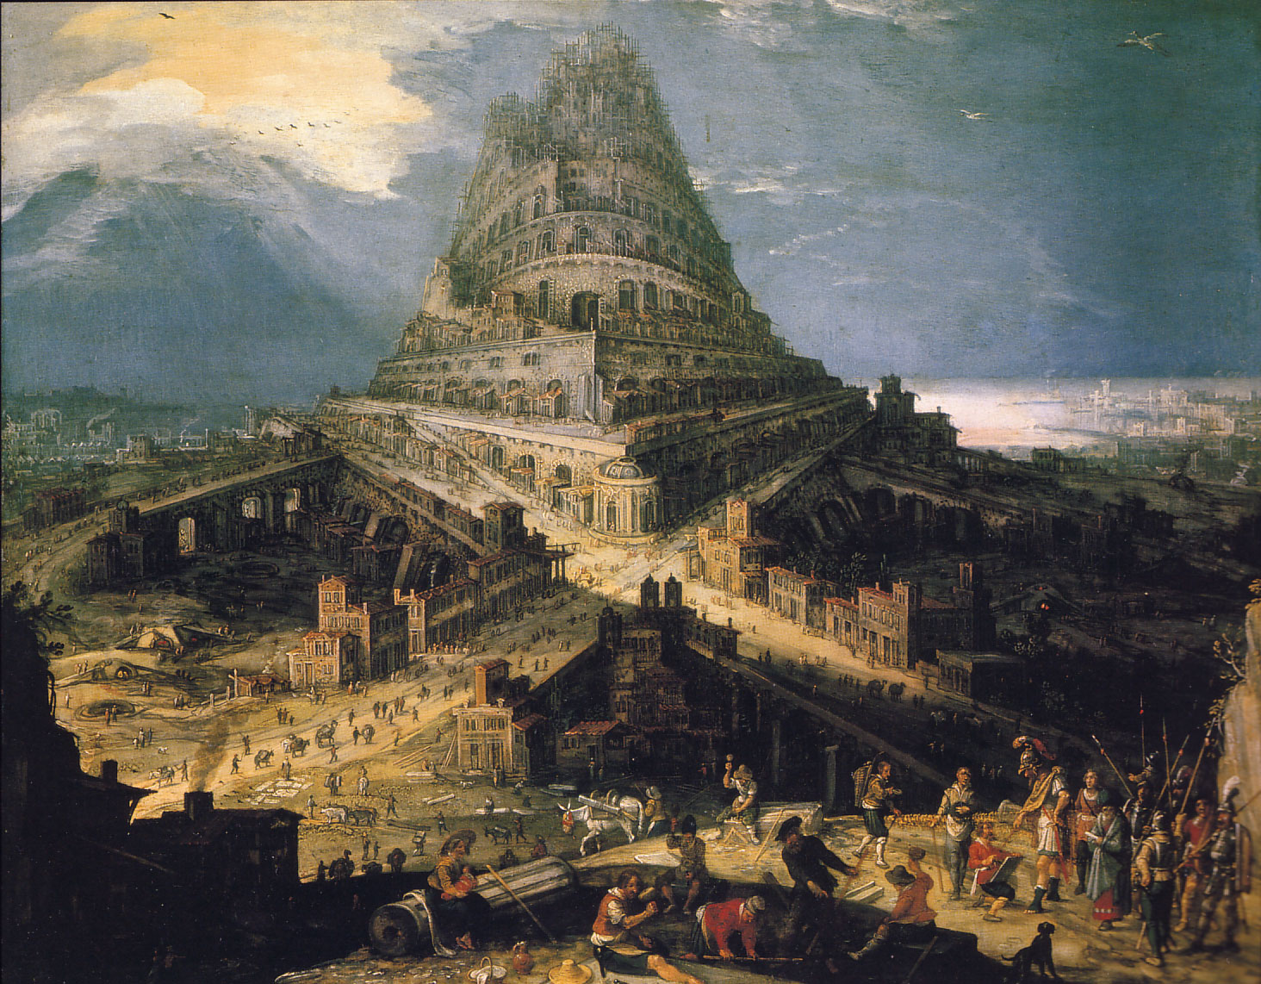
We Also Can’t Ignore…
Technical
Regulatory
Cultural
Achieving shared language and understanding between stakeholders
The Construction of the Tower of Babel (Hendrick van Clev)
Source: Wikimedia Commons

Slide 24
Outline
Definitions
Challenges
Big data
Reductionist vs. systems-level science
Opportunities
Drug repurposing
Clinical genotyping
Hypothesis generation
Discussion

Slide 25
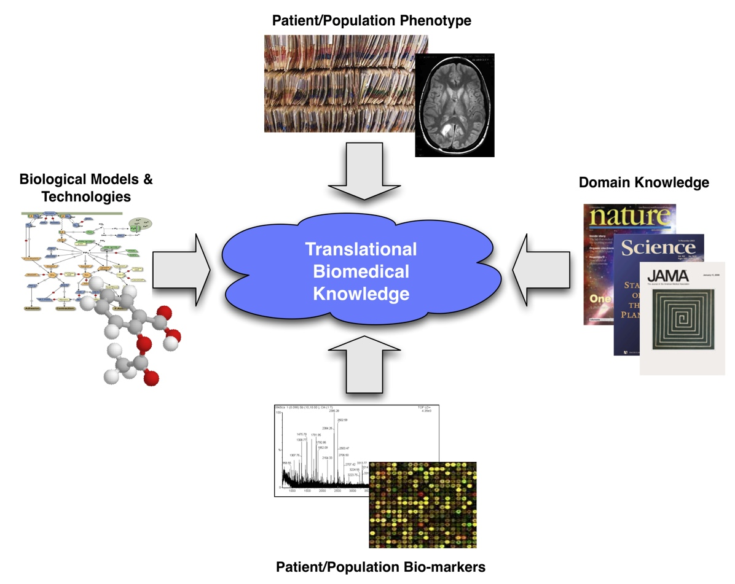
The Goal: Creating Translational Biomedical Knowledge

Slide 26
Three Examples of TBI In Action
Drug Repurposing
Clinical Genotyping
Hypothesis Generation

Slide 27
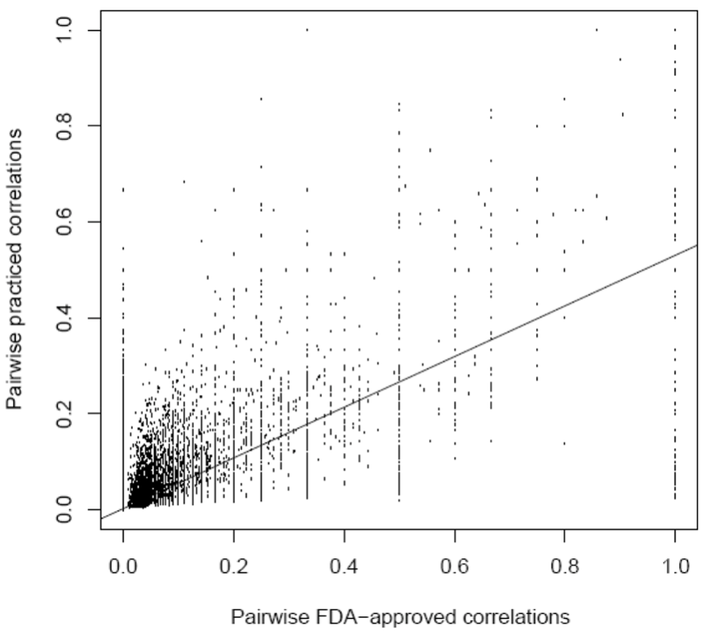
Example 1: Drug Repurposing
“Drug repositioning refers to the discovery of alternative uses for drugs”
Challenges:
Choosing the indication for a drug to use when testing such hypotheses
Availability and heterogeneity of data sets
Methods:
“guilt by association” approach.
Outcomes:
“When compared with a control group of drug uses, the suggested novel drug uses generated by this approach were significantly enriched with respect to previous and ongoing clinical trials.”
Pair-wise drug-disease correlations based on contents of DrDKB and similarity of drug treatment profiles
Adapted from: SYSTEMATIC EVALUATION OF DRUG-DISEASE RELATIONSHIPS TO IDENTIFY LEADS FOR NOVEL DRUG USES. Annie P. Chiang, Atul J. Butte. Clin Pharmacol Ther. March 10.

Slide 28
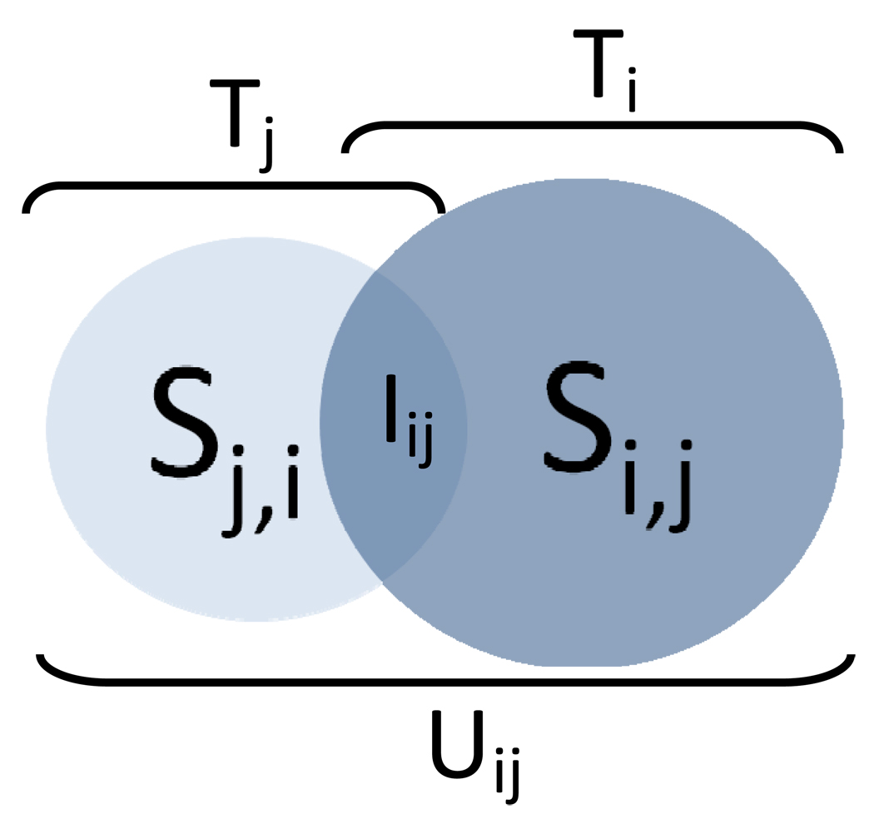
“Guilt By Association” Approach
Schematic of the guilt-by-association method of suggesting leads for novel drug uses. Given two diseases i, j and their corresponding treatment profiles Ti and Tj, respectively, the suggested novel drug uses for i based on shared treatment profile with j is Si,j or the difference of the union treatment profile (Uij) and Ti. Conversely, suggested novel drug uses for j based on i (Sj,i) are obtained from subtracting Tj from Uij.
Adapted from: SYSTEMATIC EVALUATION OF DRUG-DISEASE RELATIONSHIPS TO IDENTIFY LEADS FOR NOVEL DRUG USES. Annie P. Chiang, Atul J. Butte. Clin Pharmacol Ther. March 10.

Slide 29
Example Results: Novel Applications Not Found in Clinicaltrials.gov
Adapted from: SYSTEMATIC EVALUATION OF DRUG-DISEASE RELATIONSHIPS TO IDENTIFY LEADS FOR NOVEL DRUG USES. Annie P. Chiang, Atul J. Butte. Clin Pharmacol Ther. March 10.

Slide 30
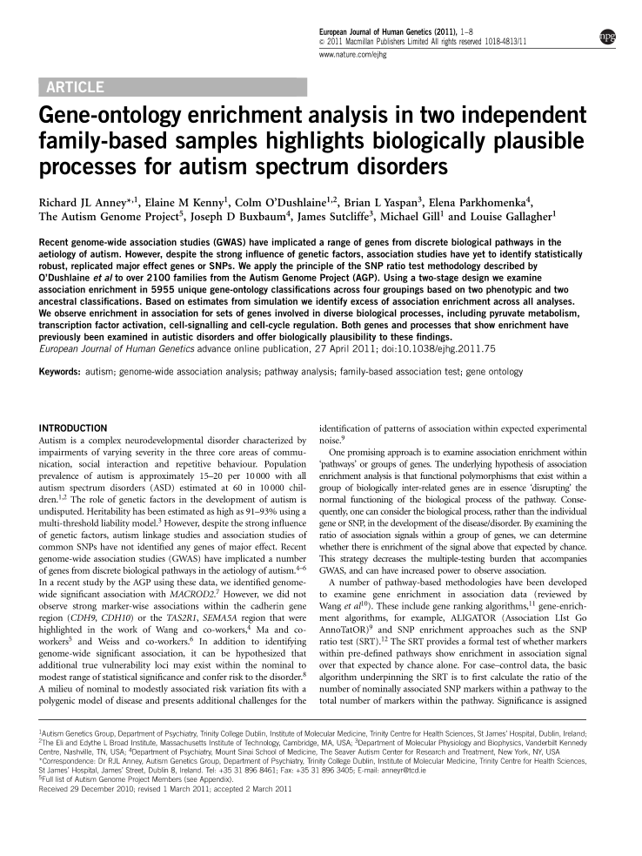
Example 2: Gene Ontology Enrichment
“Recent genome-wide association studies (GWAS) have implicated a range of genes from discrete biological pathways in the etiology of autism. However, despite the strong influence of genetic factors, association studies have yet to identify statistically robust, replicated major effect genes or SNPs.”
Challenges
Systematic annotation of GWAS data
Failure of traditional statistical methods
Methods
GO enrichments of study data sets
Outcomes:
“We observe enrichment in association for sets of genes involved in diverse biological processes, including pyruvate metabolism, transcription factor activation, cell-signalling and cell-cycle regulation. Both genes and processes that show enrichment have previously been examined in autistic disorders and offer biologically plausibility to these findings
Adapted from: GENE-ONTOLOGY ENRICHMENT ANALYSIS IN TWO INDEPENDENT FAMILY-BASED SAMPLES HIGHLIGHTS BIOLOGICALLY PLAUSIBLE PROCESSES FOR AUTISM SPECTRUM DISORDERS. Richard J L Anney et al. European Journal of Human Genetics. April 11.

Slide 31
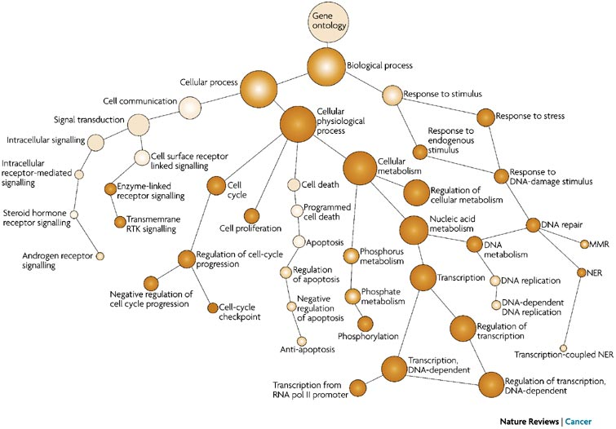
Gene Ontology (GO): Structure and Function of Genes and Gene Products
Adapted from: COMPUTATIONAL PREDICTION OF CANCER-GENE FUNCTION. Pingzhao Hu, Gary Bader, Dennis A. Wigle & Andrew Emili. Nature Reviews Cancer 7, 23-34 (January 2007)

Slide 32
GO Enrichment
Targeted Data Set
Input: Annotation with GO Concepts
Quantitative Analyses
Output: Knowledge-anchored Expression Levels (structural and/or functional)

Slide 33
GO Enrichment Tools
http://www.geneontology.org/GO.tools_by_type.term_enrichment.shtml

Slide 34

Example 3: Hypothesis Generation
Asking and answering important questions in large scale, multi-dimensional data sets
Challenges:
Heterogeneity of data sets
Availability of knowledge resources that can be used to annotate targeted data
Methods:
Constructive induction
Outcomes:
Able to identify novel hypotheses relating bio-molecular markers and clinical phenotypes that may be able to inform diagnostic or therapy planning approaches to multiple cancers
Phenotype
Bio-molecular Markers
Biospecimens

Slide 35
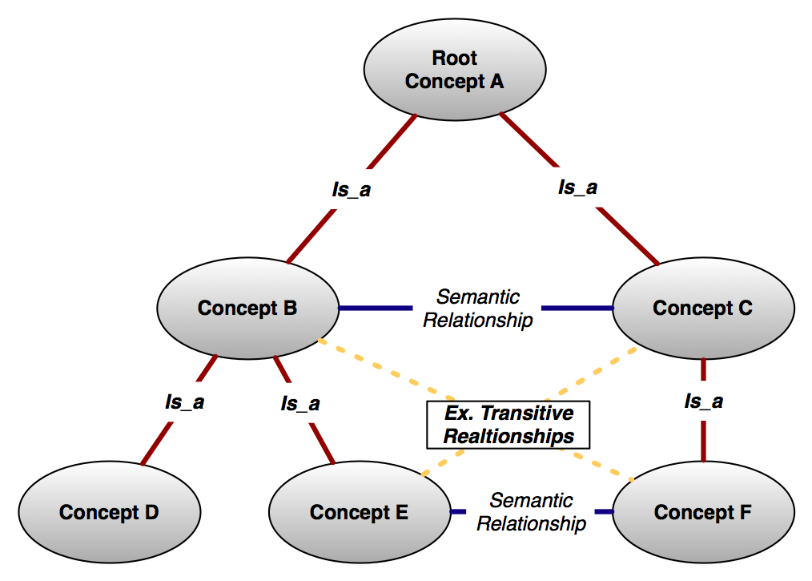
Leveraging Conceptual Knowledge
Conceptual knowledge defined by:
Atomic units of information
Semantically meaningful relationships between those atoms
Examples sources of conceptual knowledge:
Ontologies
Abstract, simplified view of the world that we wish to represent for some purpose
Basis of formally represented knowledge
Terminologies
Database Schemas
Literature extracts
Conceptual entities and semantic relationships extracted using text mining and natural language processing techniques

Slide 36
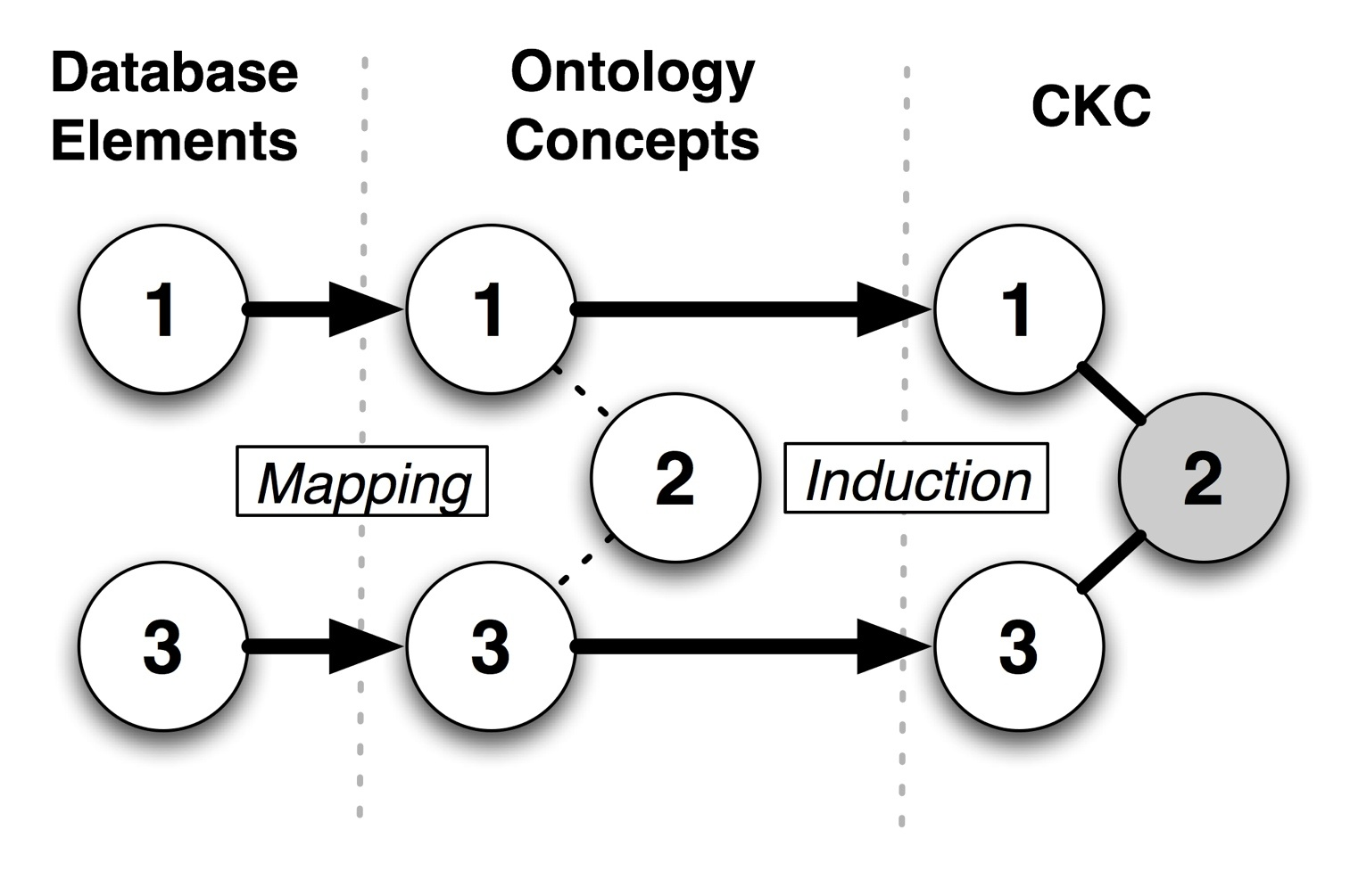
Putting Conceptual Knowledge to Work: Constructive Induction (CI) & Hypothesis Generation
Conceptual Knowledge Constructs (CKCs)
Conceptual knowledge-anchored concepts + relationships
Higher order constructs (multiple intermediate concepts)
Controls for concept granularity (search depth)
Basis for inference of hypotheses concerning relationships between data elements

Slide 37
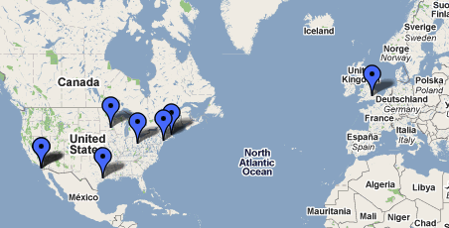
Experimental Context: CLL Research Consortium
NCI-funded Program/Project (PO1)
Translational research targeting Chronic Lymphocytic Leukemia (CLL)
Established in 1999
Cohort of over 6,000 patients
Comprehensive phenotypic and bio-molecular data sets, as well as bio-specimens
8 participating sites
Informatics platform:
Research networking
Clinical trials management
Correlative data management
Bio-specimen management

Slide 38
Multi-part CI Evaluation Study in CLL
(1) Efficacy
(2) Verification & Validation
(3) Mining Domain Literature
CKC Evaluation
108 data elements
822 UMLS concepts
5800 CKCs
5 SMEs
Random sample (250)
86% valid
90% “meaningful”
Search depth controls
TOKEn browser
Automated lit. queries
Random sample (50)
SME “gold standard”
Support metric
Critical relationship
⬇ support metric
⬆ “meaningful”
Significant correlation
Mining CLL literature
Medline, 2005-2008
Comparison
Literature-based CKCs
Ontology-based CKCs
Critical findings
No overlap
Differing granularity
More timely (SMEs)
Payne PR, Borlawsky T, Kwok A, Dhaval R, Greaves A. Ontology-anchored Approaches to Conceptual Knowledge Discovery in a Multi-dimensional Research Data Repository. AMIA Translational Bioinformatics Summit Proc. 2008.
Payne PR, Borlawsky T, Kwok A, Greaves A. Supporting the Design of Translational Clinical Studies Through the Generation and Verification of Conceptual Knowledge-anchored Hypotheses. AMIA Annu Symp Proc. 2008.

Slide 39
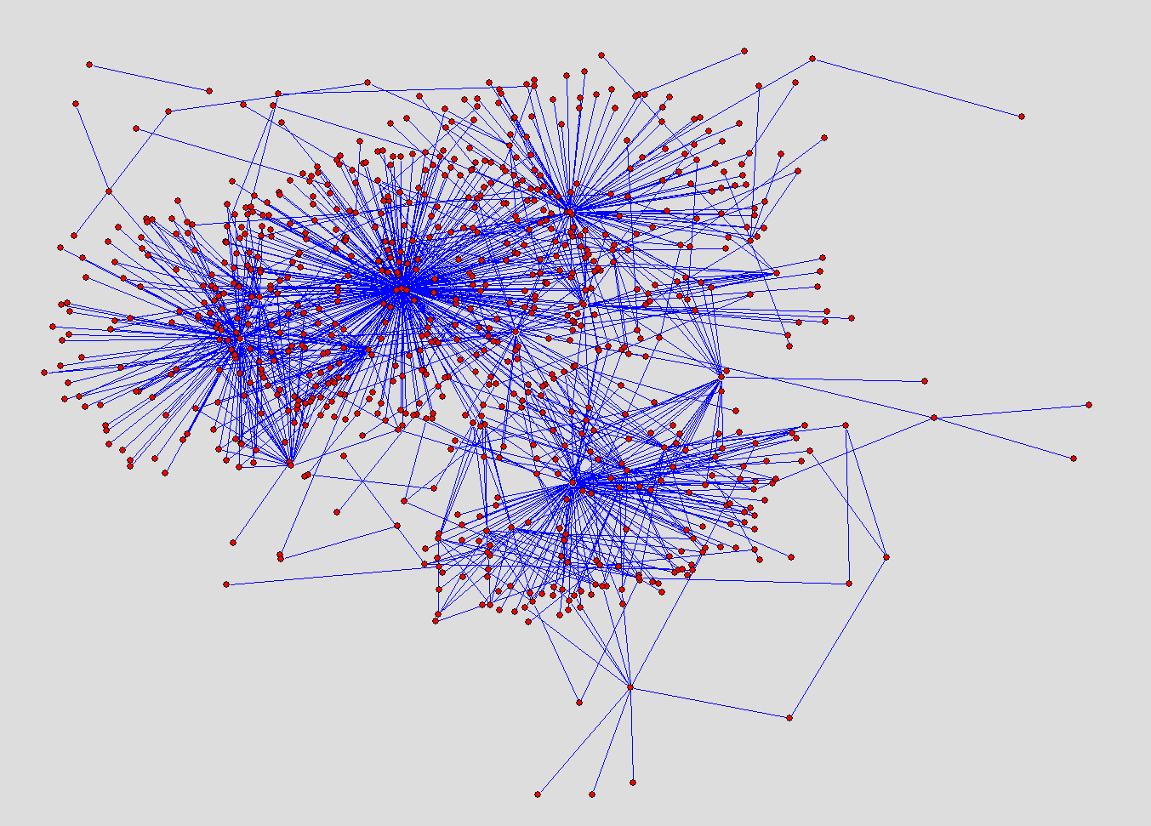
CKC Visualization
Cytogenetic & Chromosomal abnormalities
Bone Marrow Morphology
Solid Tumors
Tissues of Origin
Hematologic
Malignancies
Myelogenous Malignancies
Bio-molecular Products
TOKEn CKC Network: CLL Research Consortium Metadata

Slide 40
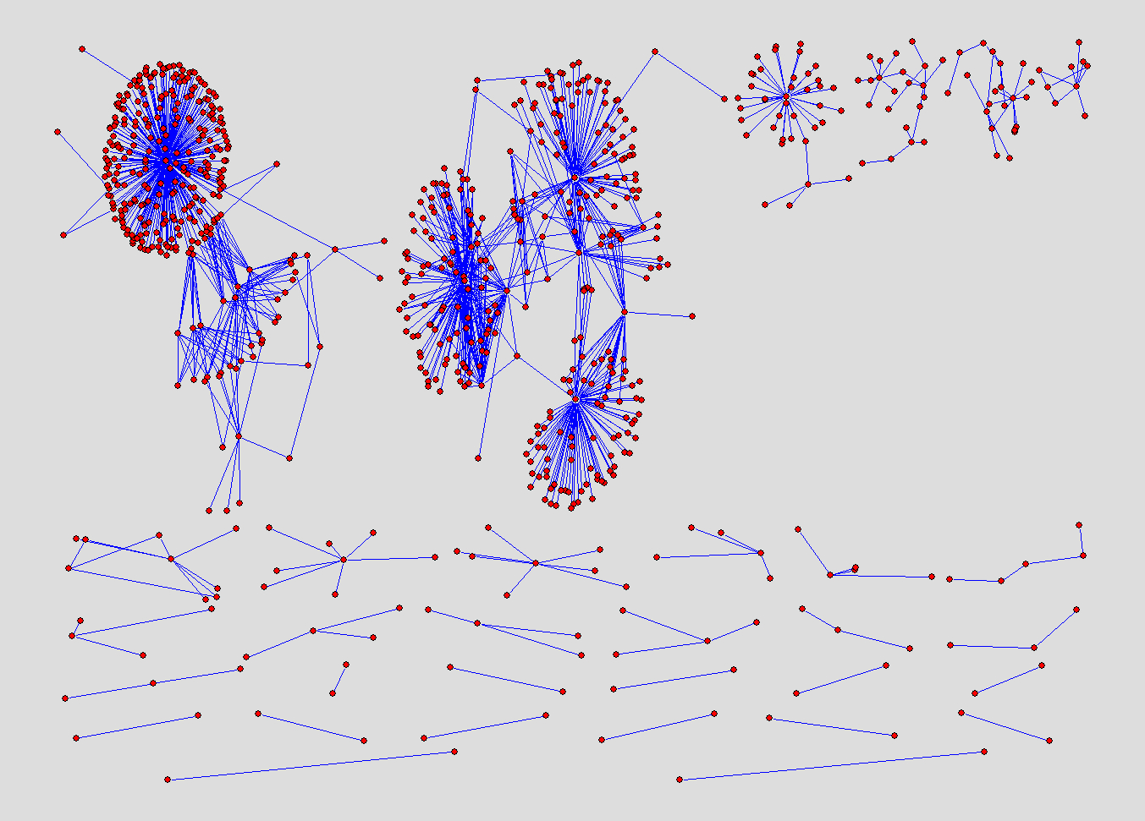
Cytogenetic Abnormalities
Chromosome Loss
Laboratory Findings
Tissues of Origin
Protein Expression
Treatment
Response
Leukemia's
Molecular Abnormalities
Tissues of Origin
Bone Marrow Morphology
Lymphomas
TOKEn CKC Network: Semantic Partitions

Slide 41
Outline
Definitions
Challenges
Big data
Reductionist vs. systems-level science
Opportunities
Drug repurposing
Clinical genotyping
Hypothesis generation
Discussion

Slide 42
Ultimate Goal: Learning from Every Patient and Improving Care
Instrument Patient Encounters
(Data + Tissue)
Generate Hypotheses
Verify and Validate Hypotheses
Apply Evidence
Improve Patient Care
(Quality + Outcomes)
Formalize Evidence
Clinical Informatics
Public Health Informatics
Translational Bioinformatics
Clinical Research Informatics
Learn from every patient encounter so that we can improve their care, their families care, and their communities care

Slide 43
This Is An Inherently Biomedical Informatics Problem!
Data
Information
Knowledge
+ Context
+ Application

Slide 44
To Achieve This Goal We Will Need A Systems Approach to Biomedicine…
Biomedical Informatics “Fabric”
Clinical Encounters
Research
Data
Generation
Knowledge
Generation

Slide 45
TBI Is A Central Component of Such A Systems Approach!
Sarkar IN, Butte AJ, Lussier YA, Tarczy-Hornoch P, Ohno-Machado L. “Translational Bioinformatics: Linking Knowledge Across Biological and Clinical Realms” Journal of the American Medical Informatics Association. 2011. Jul-Aug;18(4):354-7.

Slide 46
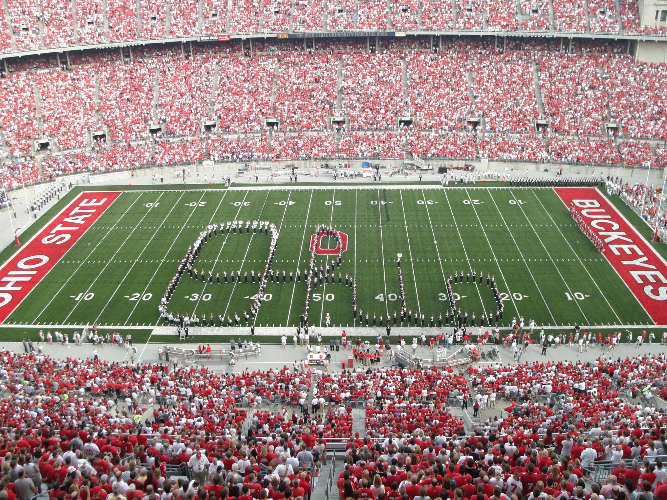
Thank you for your time and attention!
philip.payne@osumc.edu
http://bmi.osu.edu/~payne

